Slide 1

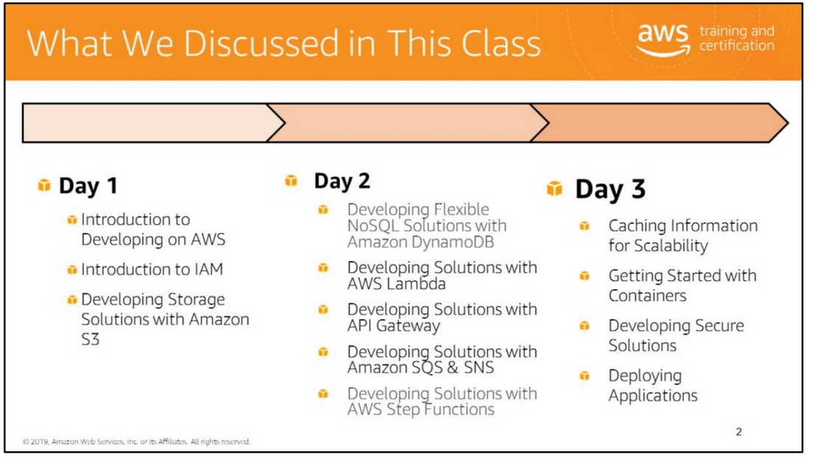
You have learned options to store application-related data in AWS. You have explored options for developing an application based on an event-driven architecture.
You have learned how to develop and deploy applications that are secure and scalable.
You have experienced a comprehensive learning approach through discussions about key concepts and practical use cases as well as hands-on labs that used the AWS SDK to develop applications.
You have not only learned how individual services work, but also discussed how to integrate services to build sophisticated solutions.

Slide 2
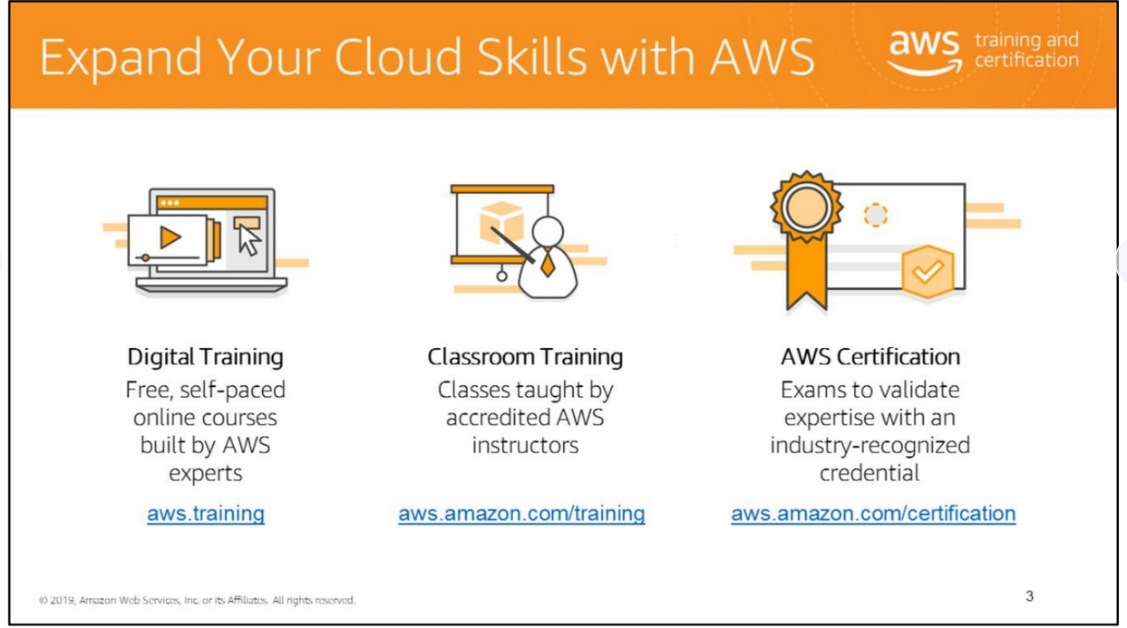

Slide 3
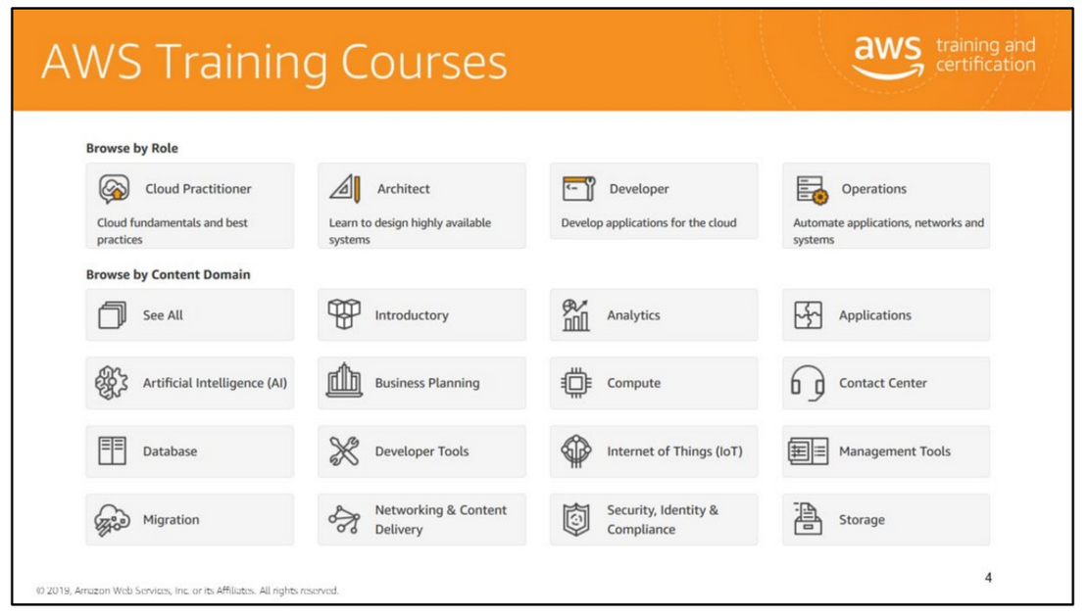
Classes are role-based and aim to be progressive as individuals gain deeper experience working with AWS services.
Discover course offerings to develop technical skills and learn best practices.
For more information, see https://www.aws.training/Dashboard.

Slide 4
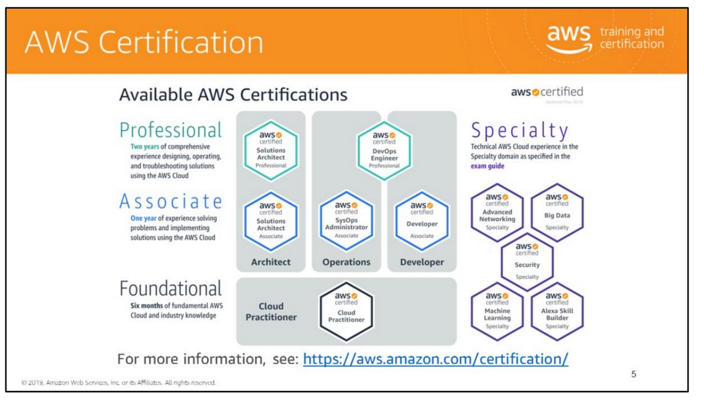

Slide 6
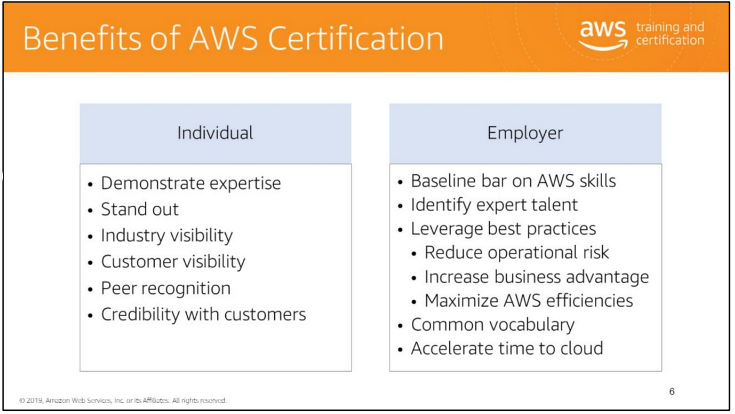

Slide 7


